Slide 1
Basics of Trees
EECS 233

Slide 2
Hierarchies Everywhere
Your local directory structure
Governmental and organizational structures
General approach of dealing with large-scale computer systems
  P2P networks
    Kazaa P2P network (peers and superpeers)
    Gnutella 2
  Hostnames
  IP addresses
  Internet
Trees are natural representation of hierarchies

Slide 3
Flashback: Phone Book
Operations:
  search for an item (and possibly delete it)
  insert a new item
If we use a list (in previous lectures) to implement a data dictionary, efficiency = O(n).
Various tree structures allow for a more efficient phone book.
data structure | searching for an item | inserting an item
a list implemented using an array (sorted) | O(log n) using binary search | O(n) because we need to shift items over
a list implemented using a linked list | O(n) using linear search | O(1)

Slide 4
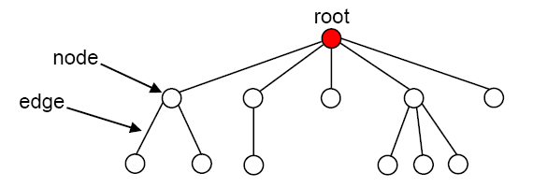
What Is A Tree?
A tree consists of:
  a set of nodes, with one of them distinguished as a root
  a set of edges, each of which connects a pair of nodes
  no cycles
Each node may have an associated data item (“payload”).
  consists of one or more fields
  key field = the field used when searching for a data item
The node at the “top” of the tree is called the root of the tree.

Slide 5
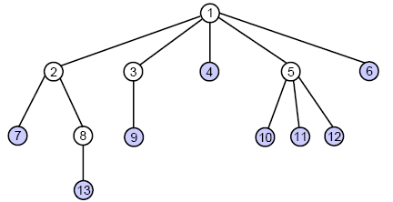
Relationships Between Nodes
If a node N is connected to other nodes that are directly below it in the tree, N is referred to as their parent and the other nodes are referred to as its children.
  example: node 5 is the parent
  of nodes 10, 11, and 12
Each node is the child of at most one parent.
Other “family terms”:
  nodes with the same parent are siblings
  a node’s ancestors are its parent, its parent’s parent, etc.
  a node’s descendants are its children, their children, etc.
A leaf node is a node without children.
An interior node is a non-leaf node (but sometimes meant as a non-leaf and non-root).

Slide 6
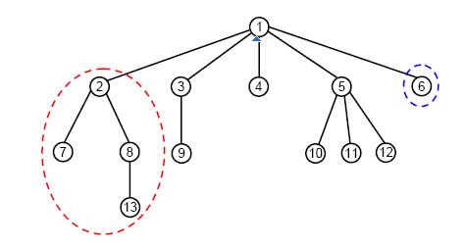
A Tree Is A Recursive Data Structure
Each node in the tree is the root of a smaller tree!
  refer to such trees as subtrees to distinguish them from the tree as a whole
  example: node 2 is the root of the subtree circled above
  example: node 6 is the root of a subtree with only one node
We’ll see that tree algorithms often lend themselves to recursive implementations.
Is an empty set of nodes a tree?

Slide 7
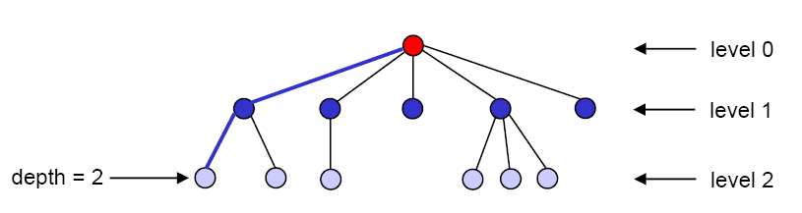
Path, Depth, Level, and Height
There is exactly one path (one sequence of edges) connecting each node to the root.
depth of a node = # of edges on the path from it to the root
Nodes with the same depth form a level of the tree.
The height of a tree is the maximum depth of its nodes.
  example: the tree above has a height of 2

Slide 8
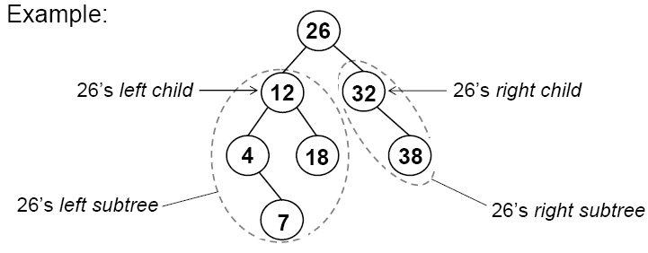
Binary Trees
In a binary tree, nodes have at most two children.
Recursive definition: a binary tree is a collection of nodes that is either:
  1) empty, or
  2) contains a node R (the root of the tree) that has
    a binary left subtree, whose root (if any) connects to R
    a binary right subtree, whose root (if any) connects to R

Slide 9
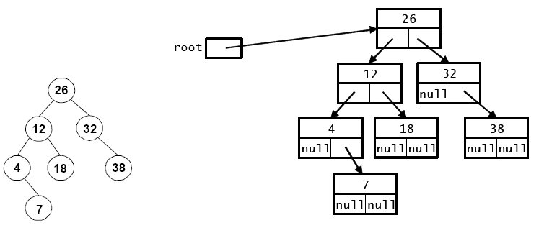
Binary Tree Representation in Java
  public class LinkedTree {
    private class Node {
      private int key;
      private String data;
      private Node left; // reference to left child
      private Node right; // reference to right child
      …
    }
    private Node root;
    …
  }

Slide 10
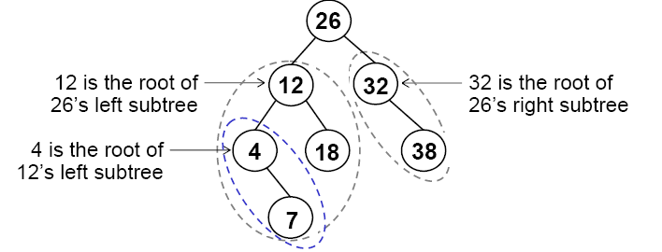
Traversing A Binary Tree
Traversing a tree involves visiting all of the nodes in the tree.
  visiting a node = processing its data in some way, e.g., print it
We will look at four types of traversals.
  Each visits the nodes in a different order.
To understand traversals, keep in mind the recursive definition of a binary tree: every node is the root of a subtree.

Slide 11
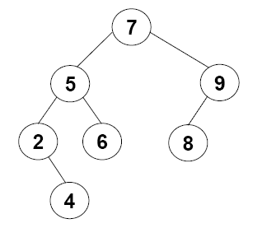
Preorder Traversal
Preorder traversal of the tree whose root is N:
  visit the root, N
  recursively perform a preorder traversal of N’s left subtree
  recursively perform a preorder traversal of N’s right subtree
Result:
7
5
2
4
6
9
8

Slide 12
Implementing Preorder Traversal in Java
  public class LinkedTree {
    …
    private Node root;
    public void preorderPrint() {
      if (root != null)
        myPreorderPrint(root);
    }
    private void myPreorderPrint(Node root) {
      System.out.print(root.key + “ ”);
      if (root.left != null)
        ?
      if (root.right != null)
        ?
    }
  }
    private class Node {
      private int key;
      private String data;
      private Node left;
      pivate Node right;
      …
    }
Notes:
We use a bit convoluted check for root being null so that this code follows the same structure as other recursive traversals

Slide 13
Postorder Traversal
postorder traversal of the tree whose root is N:
  recursively perform a postorder traversal of N’s left subtree
  recursively perform a postorder traversal of N’s right subtree
  visit the root, N
  Result: 4 2 6 5 8 9 7

Slide 14
Inorder Traversal
Inorder traversal of the tree whose root is N:
  recursively perform an inorder traversal of N’s left subtree
  visit the root, N
  recursively perform an inorder traversal of N’s right subtree
  Result: 2 4 5 6 7 8 9

Slide 15
Level-Order Traversal
Visit the nodes one level at a time, from top to bottom and left to right
AKA “breadth-first traversal”
Result: 7 5 9 2 6 8 4

Slide 16
Level-Order Traversal - Implementation
Result: 7 5 9 2 6 8 4

Slide 17
Level-Order Traversal using Queue
  Initialization: insert the root in the queue
  while queue is not empty
  Remove a node from queue
  Print the node
  Insert each child into the queue
Result: 7 5 9 2 6 8 4

Slide 18
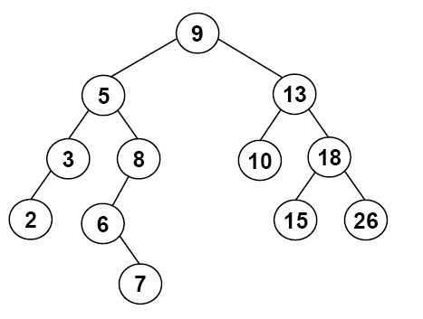
Tree-Traversal Summary
preorder: root, left subtree, right subtree
postorder: left subtree, right subtree, root
inorder: left subtree, root, right subtree
level-order: top to bottom, left to right
Perform each type of traversal on the tree below:

Slide 19

Back to Fibonacci:
Order-of-Traversal versus Recursive Calls
An execution of a recursive method forms a call tree
(though not an actual tree data structure)
  public static long fib( int n )
  {
  if (n <= 2)
  return 1;
  else
  return fib(n - 1) + fib(n - 2);
  }
  Analogy
    Recursive method invocation ≡ visiting a tree node
preorder: root, left subtree, right subtree
postorder: left subtree, right subtree, root
inorder: left subtree, root, right subtree
level-order: top to bottom, left to right
Q1: Recursive calls are pre-order, post-order, in-order, or level order?
Q2: How much stack space is needed for the execution?
  Or, would fib(1000) cause stack overflow?

